Slide 1
Using Matplotlib
The documentation is online at www.matplotlib.org
many different types of plots supported
We will look at line, scatter, stacked, bar, histogram.
Look at documentation to see many other types of plots that are supported.

Slide 2
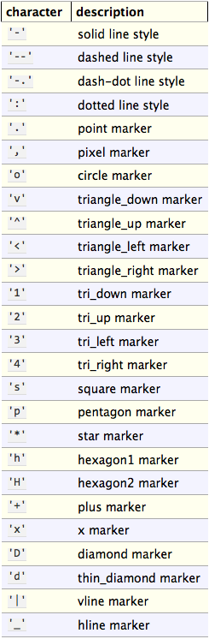
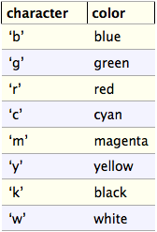
Matplotlib Markers and Colors

Slide 3
Recursion
When a function calls itself, we say it is a recursive function.
Two types of recursion
Direct
A function directly calls itself
Indirect
A function calls another function, etc. that eventually calls the original function

Slide 4
Direct Recursion
def f(x):
.
.
.
f(y)
.
.
.
return

Slide 5
Indirect Recursion
def f(x):
.
.
.
g(y)
.
.
.
return
def g(x):
.
.
.
h(y)
.
.
.
return
def h(x):
.
.
.
f(y)
.
.
.
return
def j(x):
.
.
.
f(y)
.
.
.
return
def g(x):
.
.
.
f(y)
.
.
.
return
def h(x):
.
.
.
j(y)
.
.
.
return

Slide 6
When to Write a Recursive Program
Not all problems are well suited for recursion.
Any problem that can be solved with recursion, can also be solved without recursion.
Recursive programs are typically not very efficient, but they can be coded simply.
Recursion is a good choice for problems which are easily programmed recursively, and for which performance is not a major concern.

Slide 7
How to Write a Recursive Program
To write a recursive program, you must break the problem into two separate cases
Base case:
This case covers the situation where the answer is trivial to compute, and no recursion is needed.
Recursive case:
This case covers the situation where the answer is easily written in terms of a simpler problem (one closer to the base case).

Slide 8
Recursive Function for a Countdown
We want to write a function called countdown()
What is a countdown?
Count backward printing the time, and when you reach 0, print ‘Blastoff!’, e.g., 5 4 3 2 1 Blastoff!
What is the base case?
When you reach 0, print ‘Blastoff!’
What is the recursive case?
Any value greater than 0.
Print the time and call countdown() for the remaining time

Slide 9
Recursive Function for n!
What do we know about n!?
n! is defined for non-negative integers [0, ∞)
n! = n * (n – 1) * (n – 2) * … * 2 * 1
= n * (n - 1)!
0! is defined to be 1
What is the base case?
n = 0 0! = 1
What is the recursive case?
n > 0 n! = n * (n – 1)!

